Slide 1
IDEAS2IDEAS: Encouraging constructive ideation in an online, mass-participation brainstorming system
Mike Krieger and YanYan Wang
CS376 Final Presentation

Slide 2
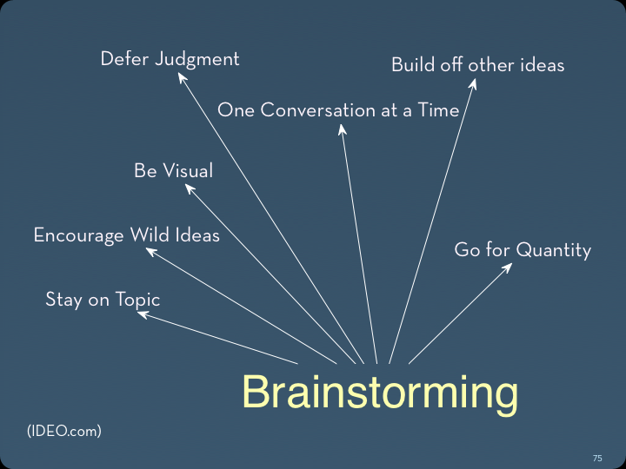

Slide 3
Summary
Building off other ideas is critical in brainstorm
Existing systems for online ‘crowdsourced’ brainstorming are poor at encouraging this behavior
Our system does significantly better

Slide 4
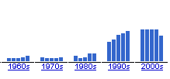
Brainstorming – Related Work
3 categories of brainstorming: Nominal, Group, and Electronic
Literature suggests nominal brainstorming outperforms group
New hybrid approach (Paulus and Yang 2000)

Slide 5

Current Industry Practice

Slide 6
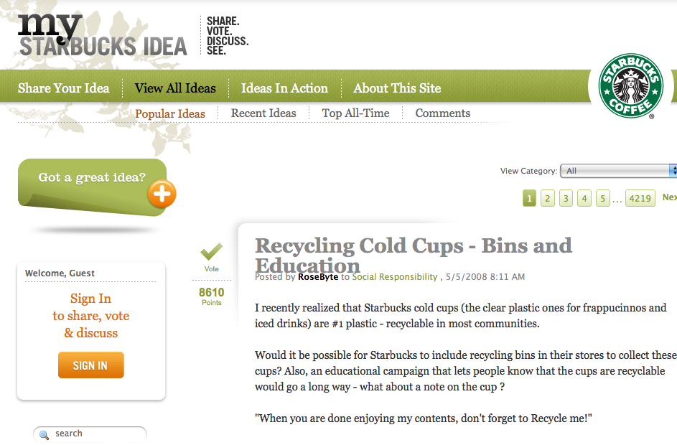
Current Industry Practice

Slide 8
Critique
Looks like Digg – we’ll act like Digg
Focus on own 2¢ rather than encouragement
Comments are divisive / negative / irrelevant
Same ideas are always at the top

Slide 9
Our 3 Design Goals
Visualize the entire sequence of ideas
Allow for quick shuffling of ideas for additional inspiration
Evoke traditional brainstorming metaphors

Slide 10
FIRST USE STUDY / DEMO

Slide 11
Evaluation
60 participants, between-subjects
Task: Contribute 2 or more ideas
Prompt: “How can technology be used to promote healthy eating?”

Slide 12
Results
IDEAS2IDEAS: 2.6 ideas per participant
DELL IDEASTORM CLONE: 2.5 ideas per participant
154 total ideas
(no significant difference in absolute participation)

Slide 13
Results
 | IDEAS2IDEAS | Dell IdeaStorm Clone
New ideas | 35 | 52
Constructive ideas | 43 | 25
χ² test of independence = 10.8776, p < 0.001

Slide 14
Next steps
A/B test more fine-tuned variations
Evaluate ideas (experts or crowds)
New ways of selecting initial ideas

Slide 15
Conclusions
System’s interface design targeted crowd of brainstormers’ behavior
Successfully encouraged constructive ideation

